Slide 1

NOWADAYS
2023 year-end

Slide 2
Catalysts and market jitters
It has been a while since the last time, which was around late June. The whole purpose of our 'meeting' today is to delve into what the US equities industry has experienced since then and to explain its status today, aligning it with various scenarios for the US economy.
In investing terms, a catalyst is some drastic event that drives the equity markets usually down. A market jitter is similar, accounting for different scenarios and effects where the investor becomes anxious about what is going on, and uncertainty prevails.

Slide 3
THE FED
Since 2022, everything we have heard about the Fed has revolved around inflation. However, there are numerous different factors that affect both inflation and the overall US economy, which the Fed needs to address. It is true that, in one way or another, nearly every area is interconnected with the so-called inflation trouble nowadays. Nonetheless, equities sometimes react differently, and what may be beneficial for the economy does not always help inflation levels or the Fed tightening cycle, and vice versa.
e.g.,
Inverse relationship between inflation and unemployment in most of the cases, or consumer spending expectations and inflation

Slide 4
TIGHTENING CYCLE
After the Fed's November meeting, and based on Jerome Powell's remarks, equity markets believe that the tightening cycle is complete. The current rate sits at 5.25-5.50%. Let's not forget that in June 2022, US inflation peaked at 9.1%, the highest since the 1980s. The tightening cycle that began in 2022 has been the most aggressive in the US in the last four decades.
Powell stated that they need to see the economy slowing down more and that they are open to being flexible depending on upcoming data. Isn't it interesting that too much resilience in the economy suggests that the problem is not yet over? Well, that's economics. However, just a couple of days later, we witnessed the largest increase in unemployment in a while – that might be enough to sway the Fed's stance for now. Furthermore, the bond market, including the 2, 10, and 30-year bonds, has experienced a significant drop this week, indicating that the job the Fed has been doing (and the job the bond market has done for the Fed) might be nearing completion.
US equities rallied in the week (S&P500 best in 2023) ending on November 3rd following Powell's statements and the interpretation of economic data, particularly in response to the drop in the bond market. This was a much-needed boost as we look forward to a positive end to the year in 2023.

Slide 5
What about the us economy
I'm sure you've heard the recent discussions about a soft landing versus a recession in the US. However, this is a completely different topic when it comes to equities and investments because, no matter how good or bad things are going, different financial instruments always offer opportunities.
In my view, only time will soon tell. The US experienced a minor recession at the beginning of 2022, and no one expected the economy and consumer spending to remain this resilient. Q3 GDP performed remarkably well, unemployment remained at all-time low levels until literally last Friday, equities rallied until July, and there's potential for another rally in the 2023 year-end weeks. Earnings have not been as bad as initially feared. Additionally, oil prices have remained stable despite conflicts in the Middle East, the bond market and the curve appear to get slowly healthier, inflation has slowed down relatively quickly and is approaching the Fed's target, and the list goes on.
As you can see, my position is that a soft landing has better odds. However, 2024 remains uncertain. Other factors still need to show signs of improvement, and there's a real possibility of inflation rebounding or other scenarios where economic indicators may go in the opposite direction of what's predicted.

Slide 6
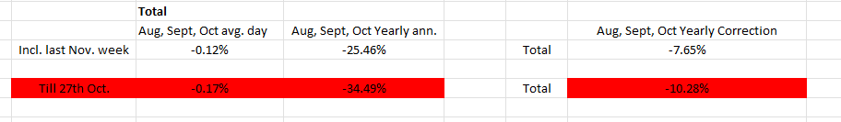
US EQUITIES - What happened since July then
YTD, until its peak on July 31st, the S&P 500 rallied almost 20%, surviving a quick 5% fall in early March following the so-called banking crisis of early 2023. It took an entire month to recover to February levels and continue rallying. In June, the 2% inflation target for the Fed seemed closer than ever, with a 3% PCE YoY. The economy and US equity markets appeared surprisingly strong to some and kept surviving the first six months of 2023 market jitters (there were big ones at some points). Inflation, the main concern back then for the economy and investors, remained under control and was getting healthier. Stock market wise, the earnings season in early August exceeded expectations as well. Almost everybody dismissed the possibility of a recession in the US and bet on an historic 2023 for equities. What then transpired in August, September, and October? July 31st to October 27th meant a 10% correction in the S&P500. I will keep noting this index as it is the main benchmark for investors.
In my eyes, the following events were responsible. I will get into them month by month following the next few slides. Do not be negative though! I am working on this ppt after one of the best weeks this year 2023. We. Are. Back.

Slide 7
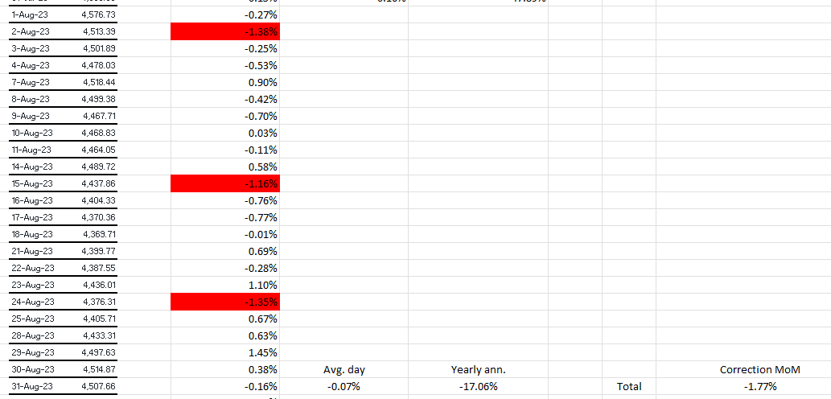
AUGUST 2023
Let me start by saying that historically, August and September are some of the worst months on average for the S&P 500 and equities in the US. Typically, investors lock in gains as well as tax losses after the vacation season. Seasonal corrections in these months are common, just as it’s common to see the index performing well at the end of the year.
In August, the S&P500 corrected itself 1.77%. Yearly annualized based on daily returns, we see a -17.06% return. In July, the same number was above 45%! The worst days and the why’s (next slide) are the following:

Slide 8
SPECIFICS
- August 2nd: sharpest drop since April, after reaching 16 months high the previous week. Nasdaq composite sank 2.2% as well. Well, Fitch cut the U.S. government credit rating given the U.S. debt situation and the possible default scenario that happened earlier in the year.
- August 15th: China shows economic weakness. Standing as the second largest economy, that is not a good signal for any US equity index given the importance China has in terms of American corporations, and even customers. Retail sales accelerated MoM in the US – but, again, that was not a good reading for the Fed regarding inflation.
- August 24th: S&P500 set to snap a 5-winning month streak. Not even a huge NVDA (the new member of the so-called Magnificent Stocks) earnings report helped that day. The Fed at Jackson Hole left the door very much open for more rate hikes this year.
- Last week green rally: A few good sessions marked one of the best weeks since April, helped by US cooling economy reports, and better-than-expected earnings from some Mega companies. On the other hand, investors started to worry again about oil prices. More to come…

Slide 9
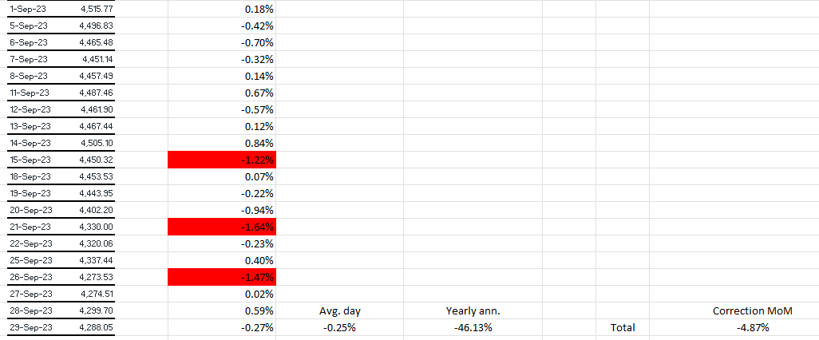
September 2023
I turn the focus to oil prices once again, excessive strong dollar, and a likely U.S. government shutdown. Bond prices kept raising as well.
In September, the S&P500 corrected itself 4.87%. Yearly annualized based on daily returns, we see a -46.13% return. Wow! The why’s (next slide) are the following:

Slide 10
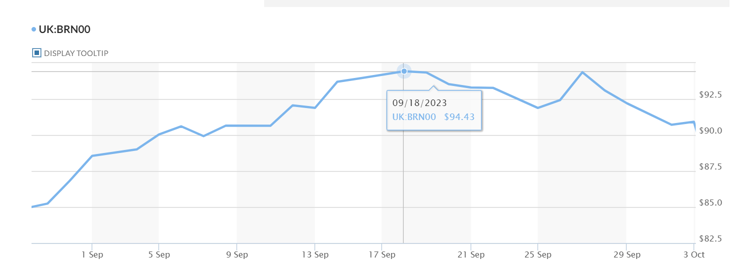
specifics
- Oil: ICE Brent Crude danced around $100 per barrel.
- Bond prices: Treasury yields kept raising at alarming levels.
- $ too strong: when the Dollar is too strong compared to the rest of the most traded currencies such as Euro, Yen, etc., it simply makes everything way more expensive for foreign non-US investors and organizations; and these two are huge for the US equity markets as well. EUR/USD ended Aug. in 1.0933, and Sept. in 1.0562. Drastic change, even though far from 2022-end levels.
- U.S. government shutdown and UAW strikes: the first one ended up not happening (they agreed on a 45-day extension), but it drove the markets down for weeks facing the ugly possibility of the Senate and the House not agreeing on important budget proposals. The problem might come back as the house voted for a new representative losing weeks to discuss the extension that ends soon again. UAW strikes did happen (and some still do) in various parts of the country. It slows the economy in different ways, and therefore induces uncertainty.
Until the first three bullet points are stabilized, US equities could not rally in green. If you add more market jitters inducing instability to that equation, you get an absolute drastic red month as we did in September 2023.

Slide 11
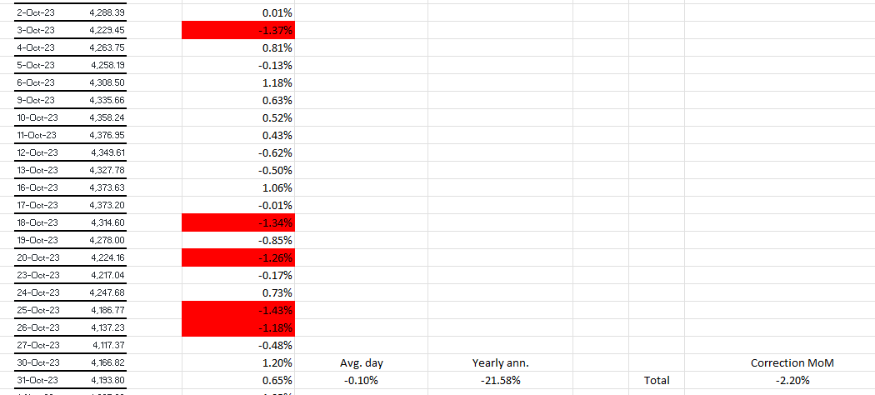
october 2023
In October, the S&P500 corrected itself 2.20%. Yearly annualized based on daily returns, we see a -21.58% return. The why’s (next slide) are the following:

Slide 12
specifics
In the last few months, only the energy sector in equities was in the green, primarily due to soaring oil prices. In October, energy prices stabilized more than expected, which was particularly surprising given the events we are about to discuss. What were the key factors during the next few weeks?
Well, we start with the Middle East conflict that began on October 7th. The US equity markets were not as affected, and the energy and defense sectors closed higher; however, it once again signifies instability and uncertainty. Let's note the surprising stabilization of Brent Crude oil, given the possibilities of escalation in the conflict.
In politics, uncertainty continued to prevail. The US government remained at an impasse on important matters, mainly regarding Ukraine and now Israel, with financial packages and Southern border conflicts, among other issues. UAW strikes were still ongoing, although towards the end of the month, some car manufacturers began to reach deals in favor of the unions.
Treasury yields reached levels not seen in the last fifteen years. The yield on the benchmark 10-year US Treasury note rose above 5.0% for the first time since July 2007. It looked quite concerning before October 27th, and these were in the US equity's main driver seat for days, but as discussed earlier, the last trading sessions of October saw a cooling down of dozens of basis points. Great…
Lastly, the Fed appears to be more positive about ending the tightening cycle. The main question for investors now is when we will see rate cuts. So, grab a chair and be patient. Not only that, but the earnings season was great overall. Most mega companies, besides Alphabet and a 'shaky' Apple (due to proof of weakness in the Chinese market and a slump in hardware sales, the longest since 2001), performed well. We believe investors should be happy regarding this matter as we have the holiday earnings season ahead of us.

Slide 13
next
I just resumed what trading US equities was in the last few months, and we had much else going on in the first part of the year. Some of it was good, but some was not. However, equities remained strong. It is true that volatility has been very much present. It is also true that other financial instruments could have been a smarter way of investing lately. Nonetheless, what beats the US equity markets? We are on the path to an average year's return in the S&P 500, boosted by Mega companies and AI, in a year that many expected to be all in the red. There is always something. There is always an opportunity window. The year is not over yet, and it seems we have the possibility of continuing to rally at the end in the same way we did until the summer.

Slide 14
sources
Yahoo Finance
Bloomberg Terminal
Forbes
Market Watch
FED
BEA
BLS

Slide 15

No catalyst seems to slow down us equities!

